Slide 1


Health Care System Using Android Development
IV Year B.Tech II Semester– Major Project Review
Team Members Details
1. GONGATI SANDEEP KUMAR REDDY 20N31A6722
2. CH VARSHA REDDY 20N31A6710
3. P AKHILA 21N35A6702
IV Year B.Tech – CSE(DATA SCIENCE)
Under the Guidance of
Mr A.Naveen Kumar
Assistant Professor
Department of Emerging Technologies

Slide 2
Outline
Abstract
Introduction
Existing System
Proposed System
Difference between Existing and Proposed
Literature Review
Architectural Diagram
Technical Requirement Specification
Other System Diagrams
Output screens
Conclusion & Furture Scope

Slide 3
Abstract
A good mobile application on Health Care is user-friendly to save the information of family members of current health condition.
An “Android Apps for Health Care System” is based on the concept of the development of a mobile application for health management. By using this application, it will be very easy to maintain healthcare system.
This multifaceted approach aims to elevate the standard of healthcare delivery by providing users with a centralized hub for medical information, consultations, and health management.
The application serves as a comprehensive platform, fostering efficient communication and collaboration among patients, doctors, and laboratories.
The implementation of this Health Care System aims to improve healthcare accessibility, reduce administrative burdens, and enhance overall patient outcomes through the integration of mobile technology.

Slide 4
Introduction
Healthcare consistently has been an important thoughtful concern all the time for humankind. In the last decade, with the fast development in web and internet technologies, smart hospitals have developed manifest in our lives.
Advancement in the technology has changed the world so far along with development of smart phones and other handheld gadgets. Good health is the basic necessity of good life.
This Android application aims to simplify and enhance various aspects of healthcare, making it more accessible, efficient, and personalized.
By leveraging the capabilities of smartphones, we intend to bring healthcare at your fingertips, offering a seamless and user-friendly experience for both patients and healthcare providers.
Our Android application is designed to make health management easy and accessible for everyone.

Slide 5
Existing System
Healthcare providers relied on manual appointment scheduling systems, typically involving paper-based calendars or appointment books. Patients would often need to visit the healthcare facility in person or call to schedule appointments.
Emergency services were typically accessed through landline phones. In emergency situations, individuals had to call emergency services, and location information was communicated verbally.
We had to go to the hospital to pick up our laboratory and scanning reports. Then, we talked to the doctor about what was in the reports.
Consultations between healthcare providers and patients primarily occurred face-to-face. Remote consultations were limited, and patients had to be physically present for routine check-ups, follow-ups, or discussions about their health.
Many applications are available to provide information about the locations of the doctors and the hospitals. However, users find difficult as the information must have been updated long before.

Slide 6
Proposed System
In our new health app, everything you need is in one place. Easily find details, appointment schedules, patient records, lab reports, and articles—all at your fingertips.
Our project includes registration of patients, storing their details into the system, and also computerized billing in the pharmacy, and labs.
We manage patient health records and store electronically in secure manner. This would aim to eliminate the reliance on paper records, allowing for easier access and updates.
A computer-based system to automate the scheduling of appointments. Patients could potentially schedule their appointments using a computer at the healthcare facility.
A proposal for more advanced data security measures to protect electronic health information.And Encrypted the information by authentication.

Slide 7
Existing vs Proposed System
S NO: | Existing System | Prosposed System
1. | Healthcare providers relied on manual appointment scheduling systems, typically involving paper-based calendars or appointment books. Patients would often need to visit the healthcare facility in person or call to schedule appointments. | A computer-based system to automate the scheduling of appointments. Patients could potentially schedule their appointments using a computer at the healthcare facility.
2. | Emergency services were typically accessed through landline phones. In emergency situations, individuals had to call emergency services, and location information was communicated verbally. | Proposal for secure digital communication for emergency services, potentially enhancing emergency response.
3. | We had to go to the hospital to pick up our laboratory and scanning reports. Then, we talked to the doctor about what was in the reports. | In our new health application, everything you need is in one place. Easily find details, appointment schedules, patient records, lab reports, and articles—all at your fingertips.

Slide 8
S NO: | Existing System | Prosposed System
4. | Security relied heavily on physical safeguards, such as locked filing cabinets. Limited digital security measures in place. | A proposal for more advanced data security measures to protect electronic health information.And Encrypted the information by authentication.
5. | Consultations between healthcare providers and patients primarily occurred face-to-face .Remote consultations were limited, and patients had to be physically present for routine check-ups, follow-ups, or discussions about their health. | Our application let the users to know where the particular specialist is available nearby and whether he/she is present at the instant of time.
6. | Communication Challenges Communication between patients and healthcare providers may be limited to in-person visits or phone calls, leading to delays in obtaining medical advice or updates on treatment plans. | Centralized Database Management The system will employ a PHP-MySQL backend to centralize the storage and management of patient records, doctor details, and appointment schedules securely, facilitating easy access and retrieval of information.

Slide 9
Literature Review
S No. | Title | Author | Jounral/ Confernce | Year | Advantages | Disadvantages
1. | "Healthcare System Management using Android Application" | Sharma, R., Gupta, S. | International Journal of Advanced Research in CSE. | 2020 | Facilitates remote access to healthcare services - Improves healthcare . | Limited access to smartphones in rural populations - Dependence on stable internet connectivity .
2. | "Utilizing Android Applications for Healthcare Management" | Patel, R., Shah, S. | International Journal of Healthcare Management. | 2021 | Facilitates telemedicine and remote patient monitoring. | Limited penetration of smartphones and internet .

Slide 10
S No. | Title | Author | Jounral/ Confernce | Year | Advantages | Disadvantages
3. | "A Mobile Healthcare System Based on Android" | Zhan, Y., Wu, J., Xu, Y., & Xu, H. | International Conference on Wireless Communications & Signal Processing (WCSP). | 2010 | Remote monitoring and management of patient health conditions. Seamless integration with other mobile applications. | Data security risks related to mobile data transmission. Battery consumption concerns affecting usability.
4. | "Android Applications in Indian Healthcare: A Comprehensive Review" | Kumar, N., Jain, M. | Journal of Health Informatics in Developing Countries. | 2020 | Enhances healthcare delivery efficiency and reduces wait times for appointments. | Regulatory issues and lack of standardization in healthcare app development may impact quality and reliability.

Slide 11
Architecture Diagram or System Diagram

Slide 12
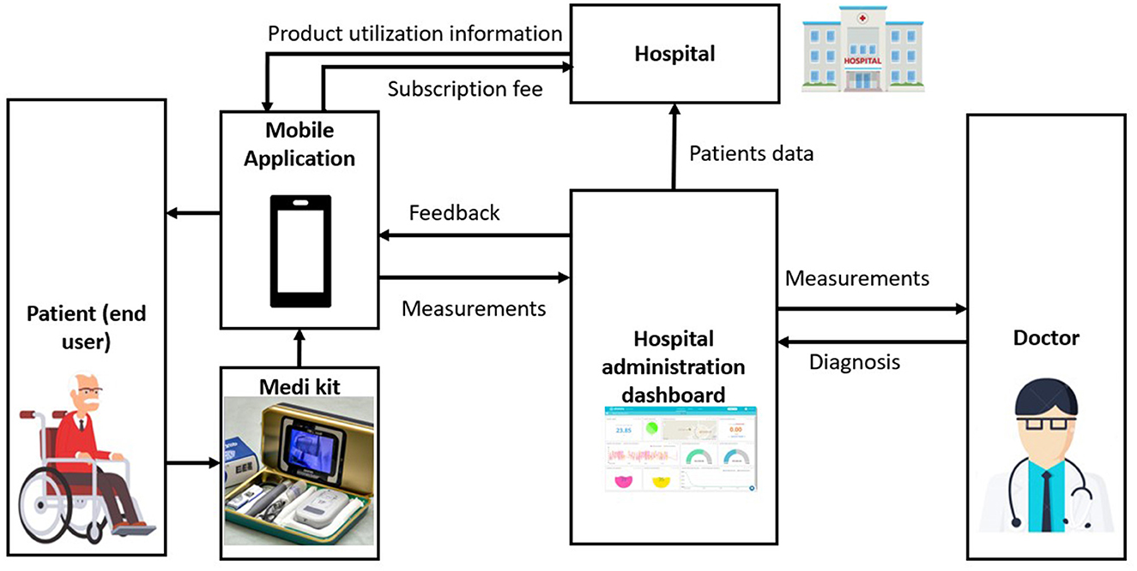
System Architecture

Slide 13
Technical Requirements Specifications

Slide 14
Software Requirement Specifications (SRS)
Operating System : Windows family
IDE : VS Code,Android Studio
Languages: Java,PHP
Database: Mysql

Slide 15
Hardware Requirement Specifications
Laptop/pc (i5ori7,16gb ram)
Router (50 mbps speed)
Hard disk (512 GB or Above)
Processor : X86 Compatible processor with 1.7 GHz Clock speed,13th gen

Slide 16
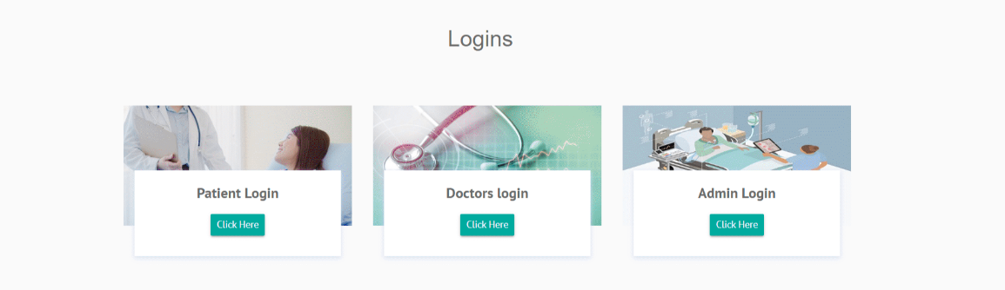
Application Modules
→Module 1- User module(Patient)
→Module 2- Doctor module
→Module 3- Admin module

Slide 17
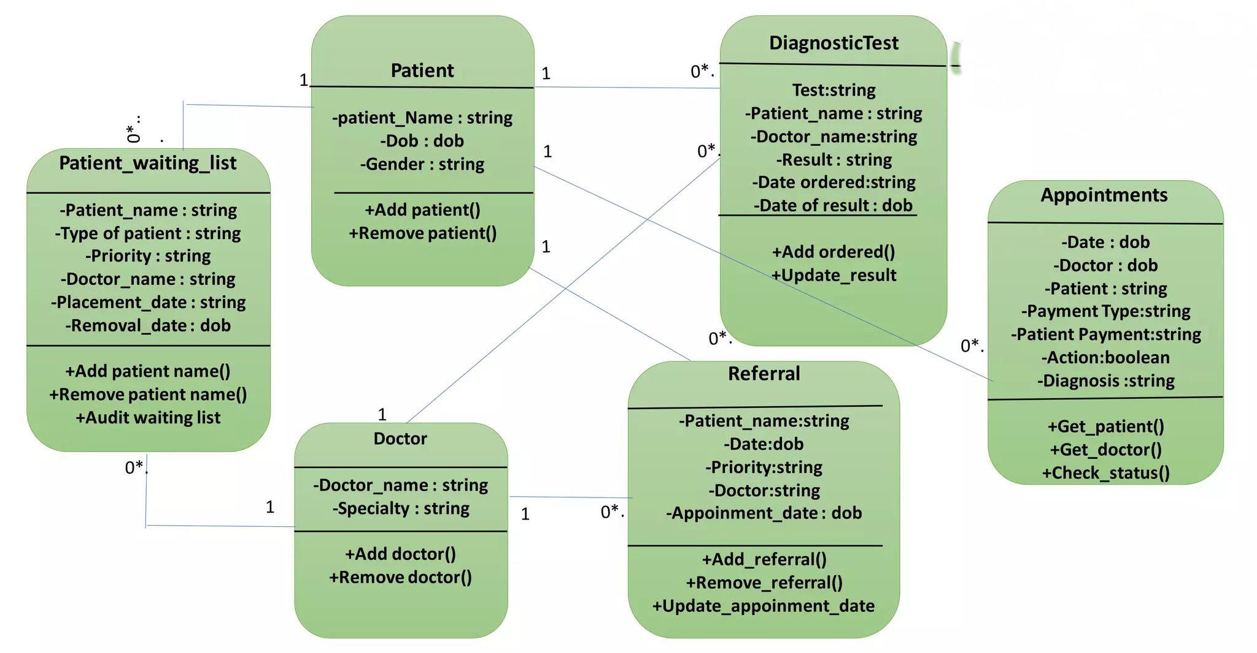
Class Diagram

Slide 18
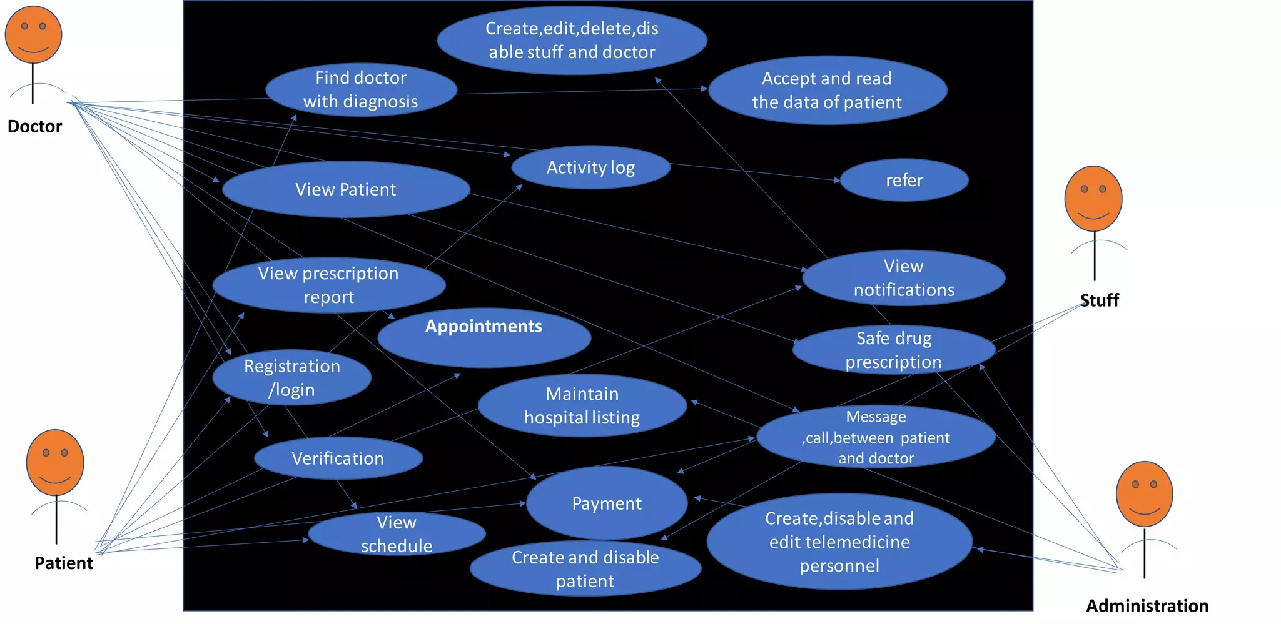
Use-Case Diagram

Slide 19
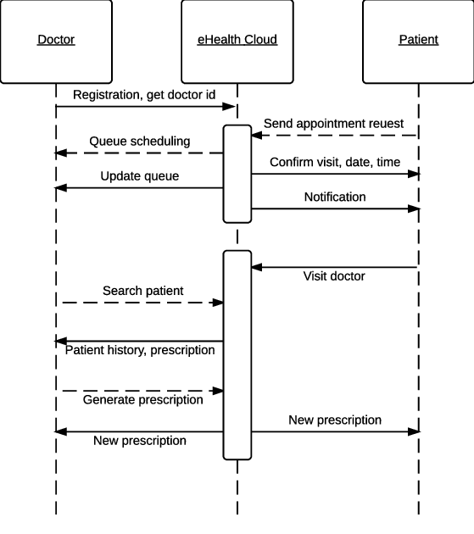
Sequence Diagram

Slide 20
Output Screens

Slide 21
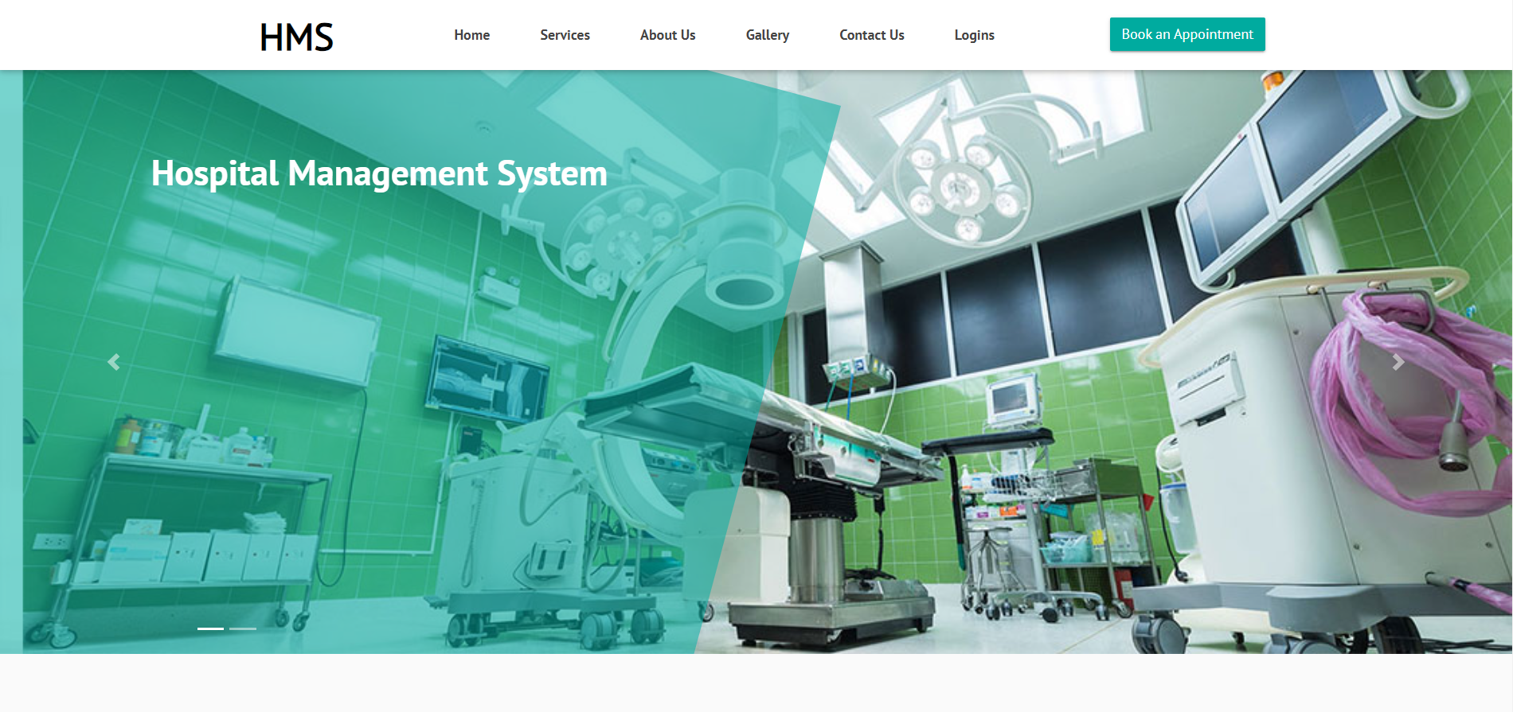
Results(Output Screenshot)
Home Page

Slide 22
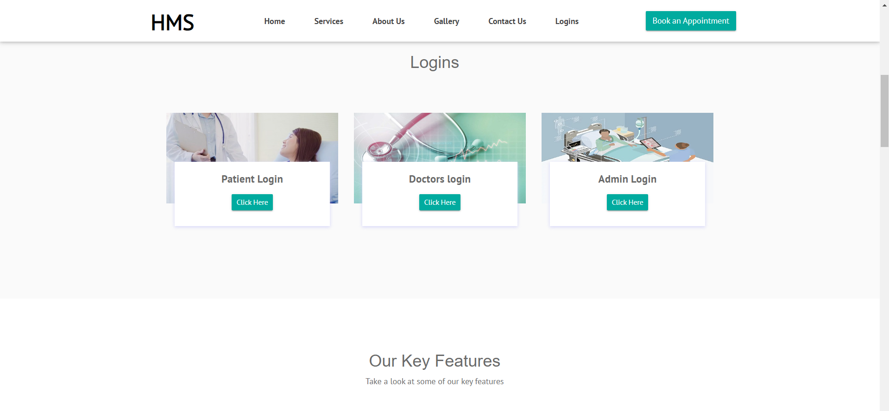
Login Page

Slide 23
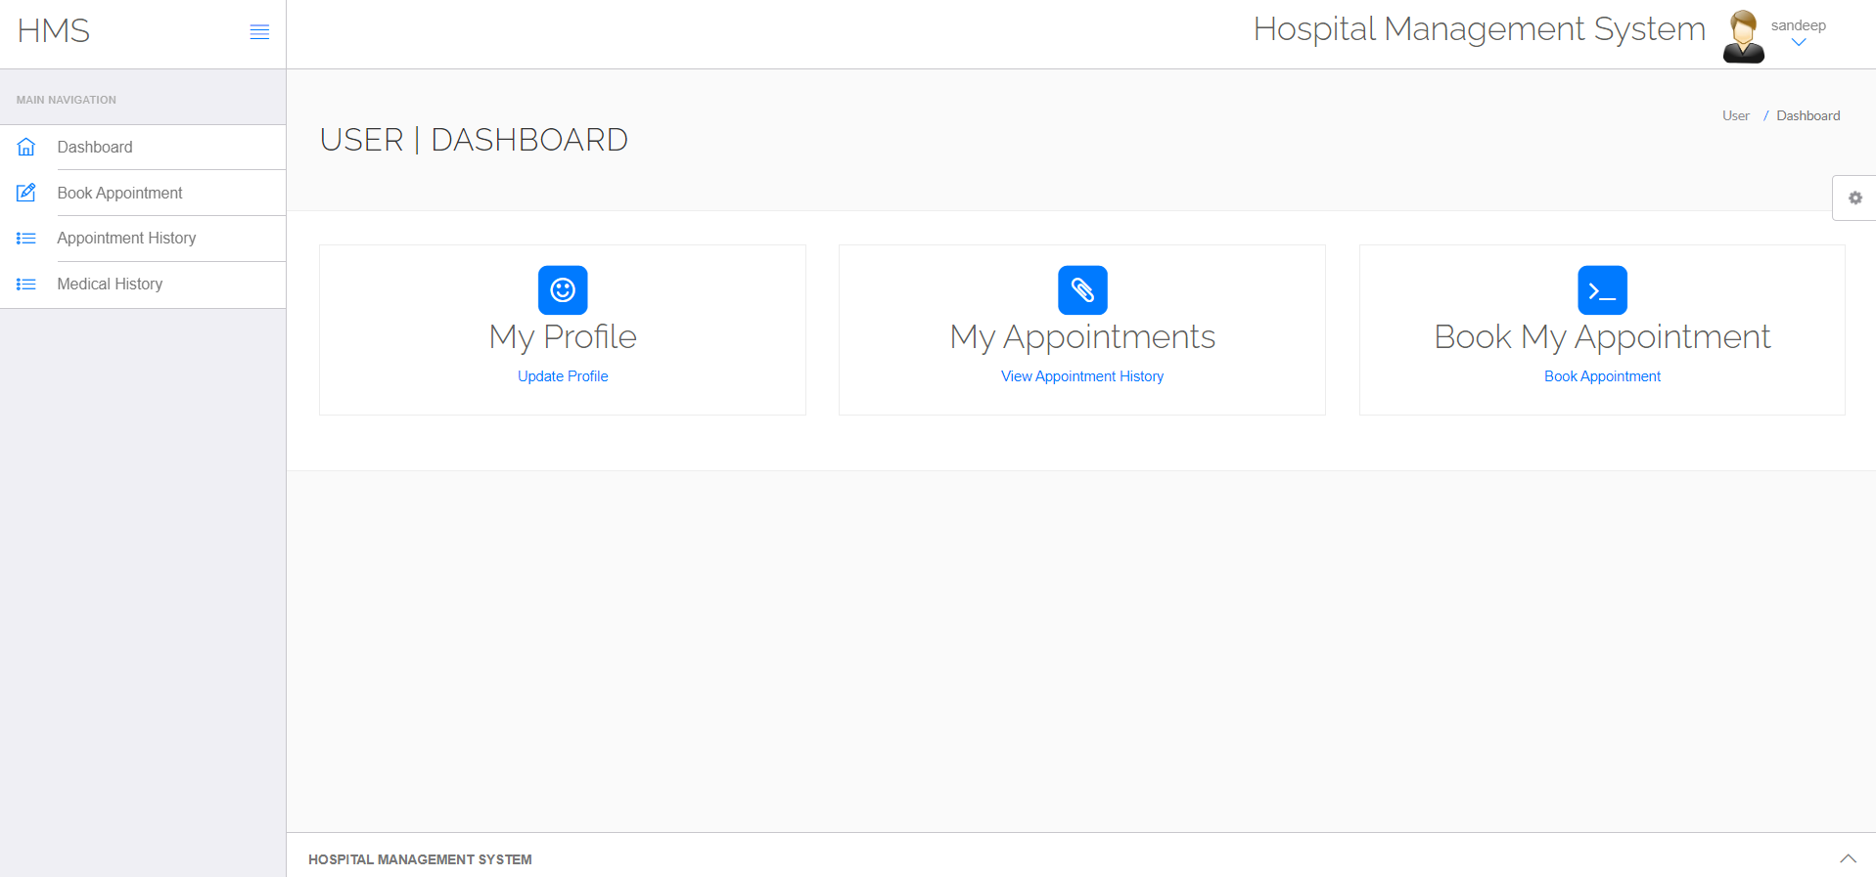
Patient Dashboard

Slide 24
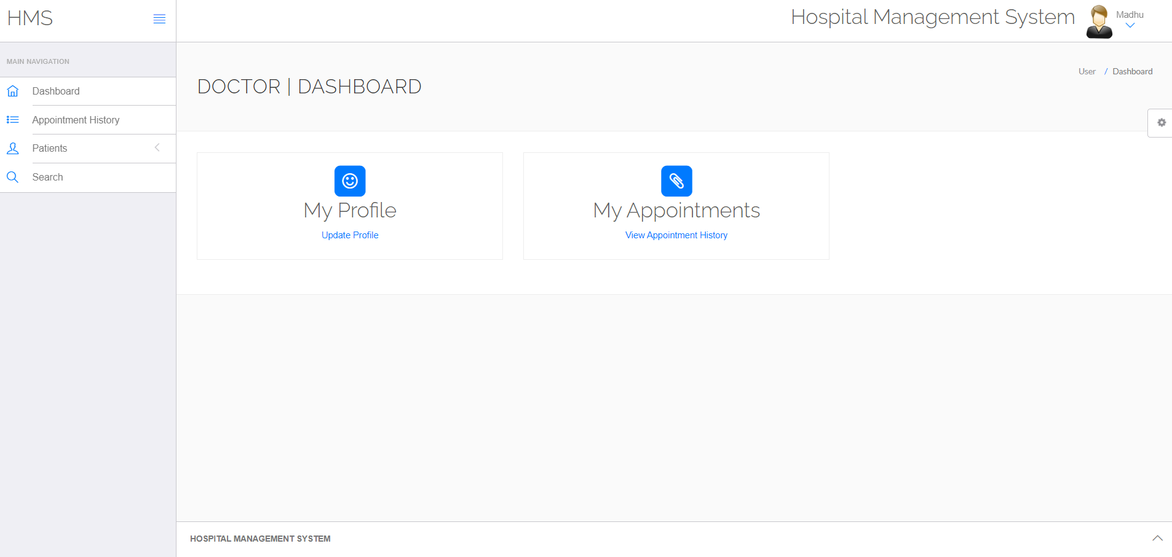
Doctor Dashboard

Slide 25
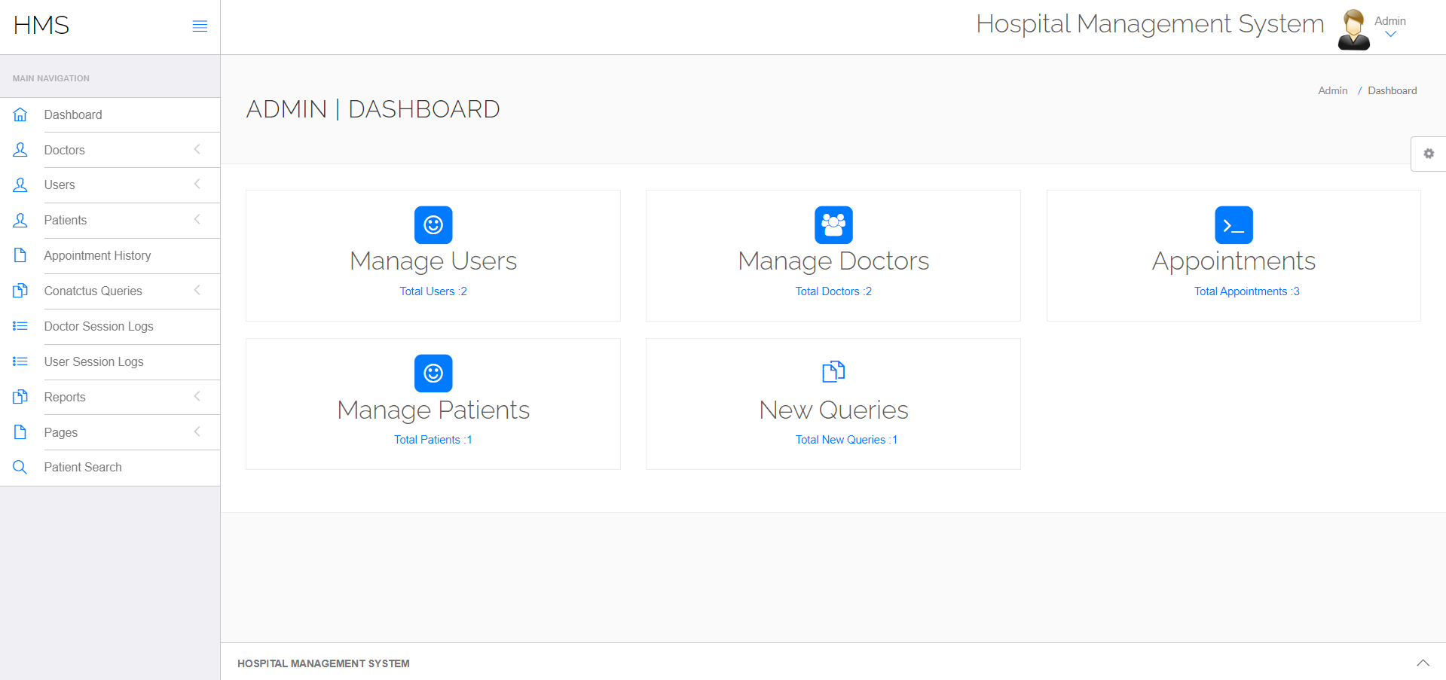
Admin Dashboard

Slide 26
About Our Application
In our new health app, everything you need is in one place. Easily find details, appointment schedules, patient records, lab reports, and articles—all at your fingertips!
There are Patient Managemenet,Administration Management, Doctor Management, Medical History Management and etc.
Our project describes “Design and Development of an Android Application for Personal Health Management System” is an enhanced instant usable application tool which user can use through the help of android base mobile devices.
By using this application every user can use it. It will be very easy to maintain family and personal healthcare and anyone.

Slide 27
Conclusion
In conclusion, the healthcare system management solution developed using Java and PHP with three distinct modules—doctor, patient, and admin—offers a streamlined approach to enhancing healthcare delivery.
The inclusion of Android application development and Visual Studio in the development environment enriches the patient module of the healthcare system management solution.
we have created a scalable and adaptable solution capable of meeting the evolving needs of healthcare organizations, ultimately contributing to improved patient care, streamlined operations, and enhanced overall healthcare delivery.

Slide 28
Future Scope
As part of the future scope for the healthcare management system, there is a strong emphasis on enhancing user experience by incorporating more user-friendly components. This initiative aims to make the system more intuitive, easy to navigate, and comprehensible for all users, including patients, doctors, and administrators.
Looking ahead, the healthcare management system developed with Java, PHP, Android application, and Visual Studio lays a solid foundation for future enhancements and expansions. The project's future scope includes the development of iOS applications alongside Android applications, broadening the reach and accessibility of the system across multiple mobile platforms.

Slide 29
Thank you...
1. GONGATI SANDEEP REDDY 20N31A6722
2. CH VARSHA REDDY 20N31A6710
3. P AKHILA 21N35A6702

